Slide 1
This ppt is for summarizing all photography knowledge.

Slide 2
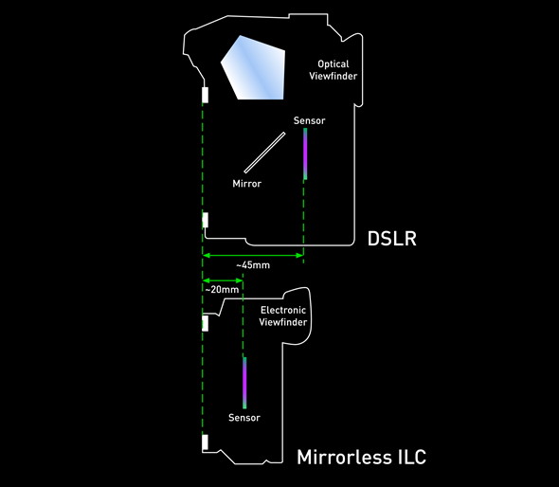
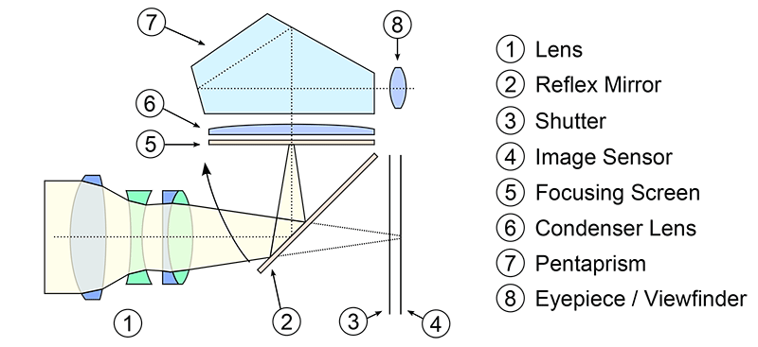
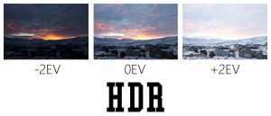
A perfect picture to illustrate the difference between
mirrorless DSLR (微单) and normal DSLR (单反)
How DSLR works
Post-Process Skills:
High Dynamic Range (HDR): The HDR technique involves taking multiple shots of the scene with different exposures (photographers call this “bracketing”). 拍几张不同Exposure的照片，然后merge （咋Merge？）

